Slide 2
What Is Deep Learning?
Deep learning is a machine learning technique that teaches computers to do what comes naturally to humans: learn by example.
Deep learning is a key technology behind driverless cars, enabling them to recognize a stop sign, or to distinguish a pedestrian from a lamppost.
It is the key to voice control in consumer devices like phones, tablets, TVs, and hands-free speakers.
Deep learning is getting lots of attention. It’s achieving the results that were not possible before.

Slide 3
What is machine learning?
Machine learning is a branch of AI and computer science which focuses on the use of data and algorithms to imitate the way that humans learn, gradually improving its accuracy.
Through the use of statistical methods, algorithms are trained to make classifications or predictions, and to uncover key insights in data mining projects. These insights subsequently drive decision making within applications and businesses, ideally impacting key growth metrics.

Slide 4
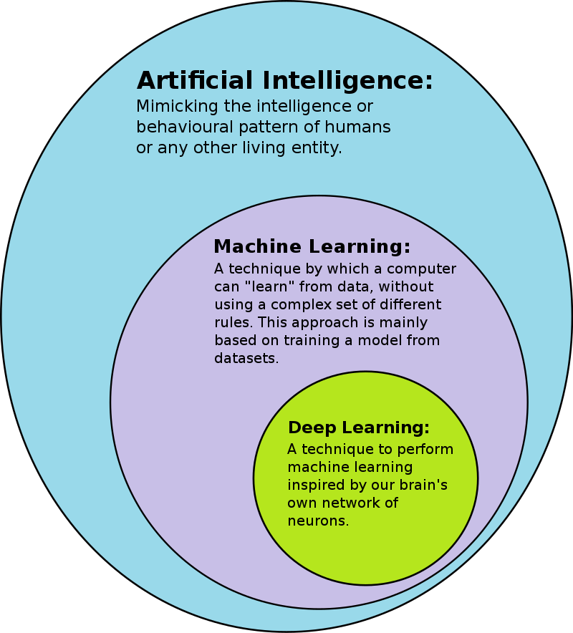
AI-ML-DL

Slide 5
Machine learning, deep learning, and neural networks are all sub-fields of artificial intelligence. However, neural networks is actually a sub-field of machine learning, and deep learning is a sub-field of neural networks.
The way in which deep learning and machine learning differ is in how each algorithm learns.

Slide 6
machine learning can use labeled datasets, also known as supervised learning, to inform its algorithm, but it doesn’t necessarily require a labeled dataset.
Deep learning can ingest unstructured data in its raw form (e.g., text or images), and it can automatically determine the set of features which distinguish different categories of data from one another. This eliminates some of the human intervention required and enables the use of larger data sets.

Slide 7
Classical, or "non-deep", machine learning is more dependent on human intervention to learn. Human experts determine the set of features to understand the differences between data inputs, usually requiring more structured data to learn.
In deep learning, a computer model learns to perform classification tasks directly from images, text, or sound. Deep learning models can achieve state-of-the-art accuracy, sometimes exceeding human-level performance. Models are trained by using a large set of labeled data and neural network architectures that contain many layers.

Slide 8
Deep learning achieves recognition accuracy at higher levels than ever before. This helps consumer electronics meet user expectations, and it is crucial for safety-critical applications like driverless cars. Recent advances in deep learning have improved to the point where deep learning outperforms humans in some tasks like classifying objects in images.

Slide 9
Deep learning was first theorized in the 1980s, but there are two main reasons that it has only recently become useful:
Deep learning requires large amounts of labeled data. For example, driverless car development requires millions of images and thousands of hours of video.
Deep learning requires substantial computing power. High-performance GPUs have a parallel architecture that is efficient for deep learning. When combined with clusters or cloud computing, this enables development teams to reduce training time for a deep learning network from weeks to hours or less.

Slide 10
Examples of Deep Learning at Work
Deep learning applications are used in industries from automated driving to medical devices.
Automated Driving: Automotive researchers are using deep learning to automatically detect objects such as stop signs and traffic lights. In addition, deep learning is used to detect pedestrians, which helps decrease accidents.
Aerospace and Defense: Deep learning is used to identify objects from satellites that locate areas of interest, and identify safe or unsafe zones for troops.

Slide 11
Medical Research: Cancer researchers are using deep learning to automatically detect cancer cells. Teams at UCLA built an advanced microscope that yields a high-dimensional data set used to train a deep learning application to accurately identify cancer cells.
Industrial Automation: Deep learning is helping to improve worker safety around heavy machinery by automatically detecting when people or objects are within an unsafe distance of machines.
Electronics: Deep learning is being used in automated hearing and speech translation. For example, home assistance devices that respond to your voice and know your preferences are powered by deep learning applications.

Slide 12
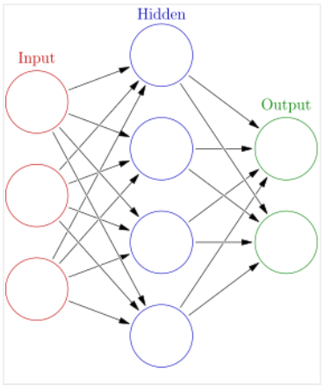
Deep learing (Deep Neural Network):

Slide 13
Difference between ML & DL
Data dependency
Hardware dependency
Feature selection
Training Time
Prediction Time

Slide 14
Deep Learning Success Stories:
Self Driving Cars
News Aggregation and Fraud News Detection
Natural Language Processing
Virtual Assistants
Entertainment
Visual Recognition
Fraud Detection
Healthcare
Personalisations
Detecting Developmental Delay in Children

Slide 15
Colourisation of Black and White images
Adding sounds to silent movies
Automatic Machine Translation
Automatic Handwriting Generation
Automatic Game Playing
Language Translations
Pixel Restoration
Photo Descriptions
Demographic and Election Predictions
Deep Dreaming

Slide 16
https://www.mygreatlearning.com/blog/deep-learning-applications/

Slide 17
McCulloch-Pitts Neuron Model
First computational model
Proposed by Warren MuCulloch (neuroscientist) and Walter Pitts (logician) in 1943

Slide 18
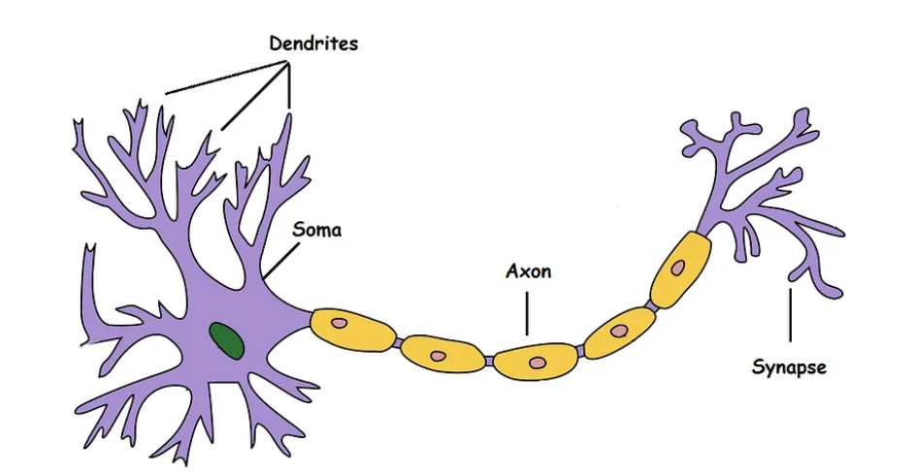
Biological Neurons

Slide 19
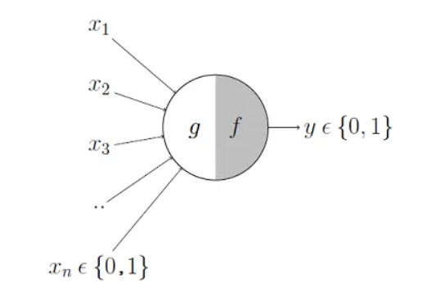

Slide 20
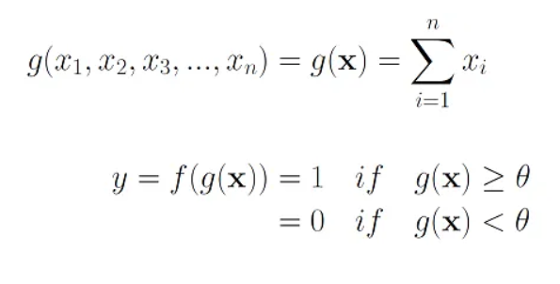

Slide 21
Threshold plays an important role in M-P model
M-P neuron has no particular training or learning algorithm
Used for implementing logic functions

Slide 22
Perceptrons: Early Deep Learning Algorithms
In 1957, Mr. Frank Rosenblatt invented the Perceptron to perform specific high-level calculations.
Perceptron is a single layer neural network and is used in supervised learning.
Perceptron is usually used to classify the data into two parts. Therefore, it is also known as a Linear Binary Classifier.

Slide 23
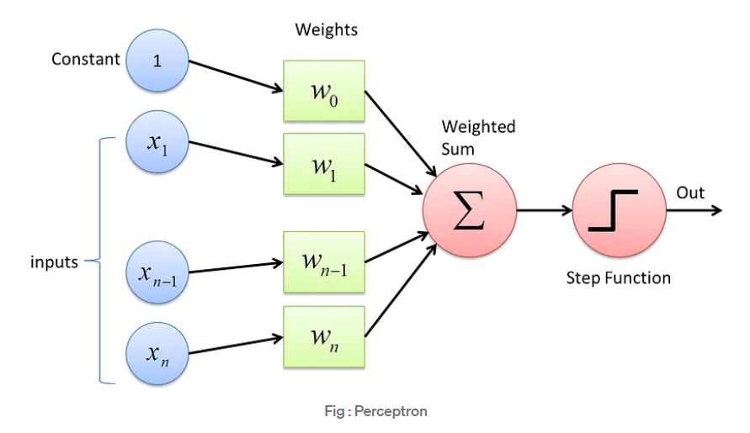

Slide 24
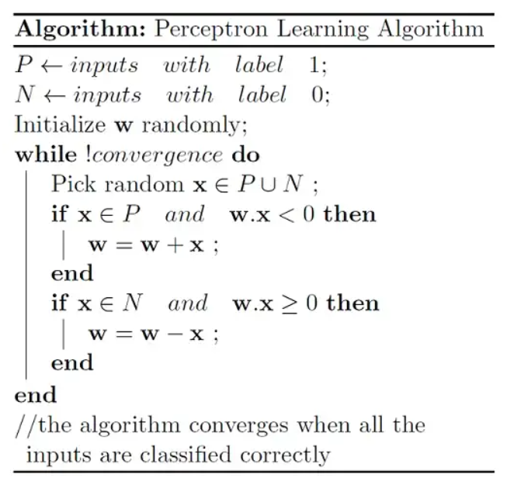
Perceptron Learning Algorithm

Slide 25
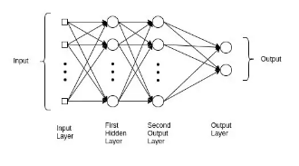
Multilayer Perceptrons (MLPs)

Slide 26
